Slide 1
DataBase design For Auto parts sale
By
Apurva Patel
Himanshu Parashar
Satwant Singh

Slide 2
Auto parts sales
We sell auto parts.
We rent toolkits to registered customers.
We keep inventory for multiple manufacturers and multiple vehicle models.
Our store are located at multiple locations.
We award loyalty points to our loyal registered customers.
PS: All sales are final.

Slide 3
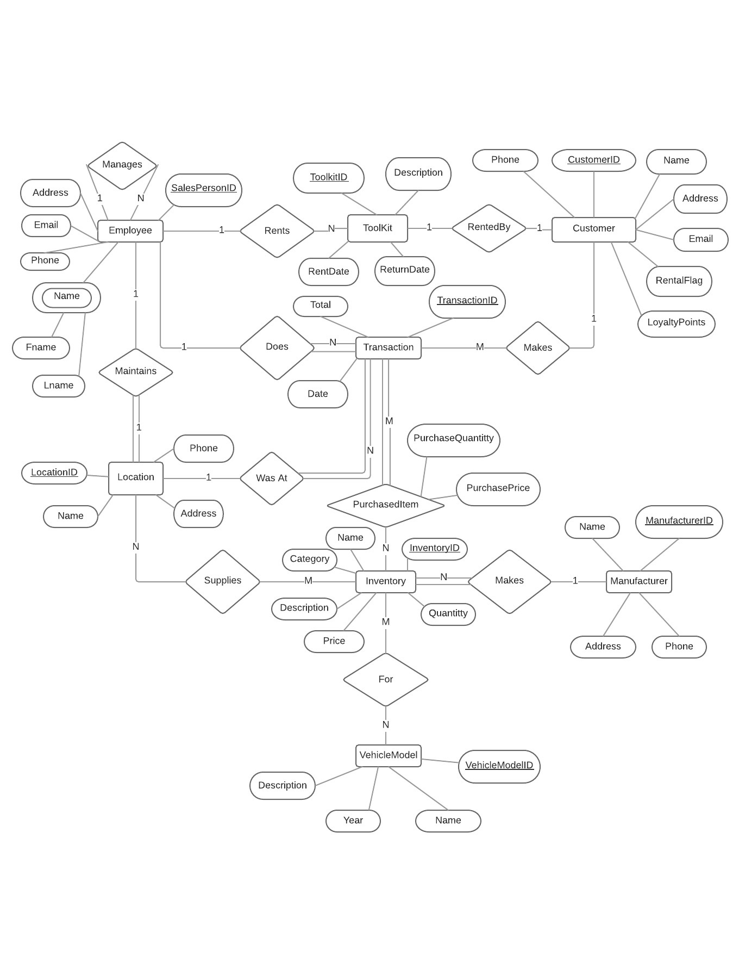
ER Diagram

Slide 4
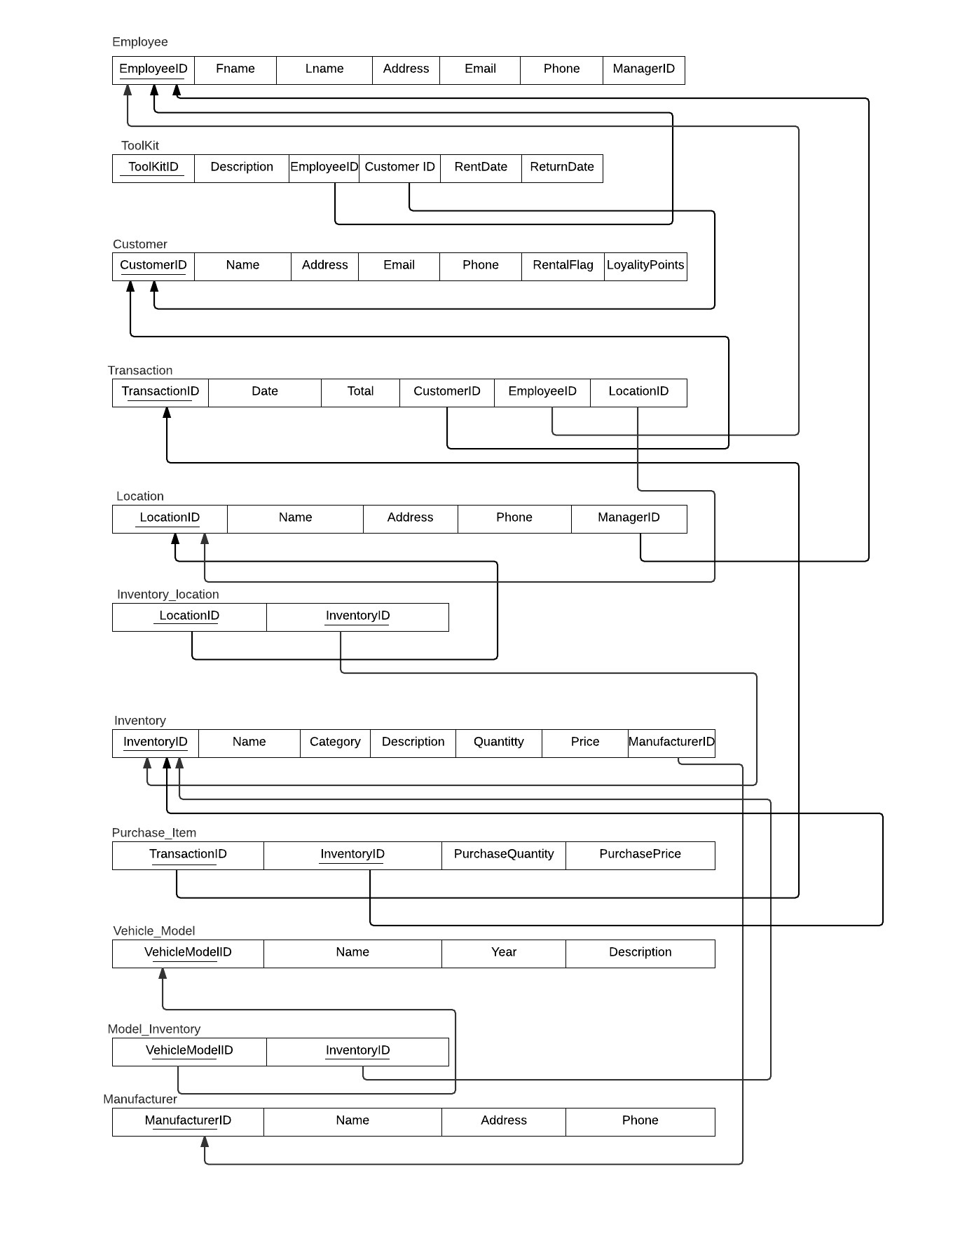
Relational Schema

Slide 5
Procedures
Sales_Transaction
Rent_Toolkit
Return_Toolkit
Revenue_Report

Slide 6
Thank you

